Slide 1

`
Long-Distance Sensing Fiber Sensor System Using Broadband
Source and Raman Amplifier
Based on: B. Y. Guo, W. C. Tang, Y. C. Manie, M. A. Bitew, H. K. Lu and P. C. Peng, "Long-distance sensing fiber sensor system using broadband source and Raman amplifier," IEEE International Conference on Consumer Electronics - Taiwan (ICCE-TW), Taipei, 2017, pp. 413-414.
Presenter: Ashish Kumar
Student ID: 108998404
Instructor: Prof. Peng-chun Peng

Slide 2
OUTLINE
Proposed work
Introduction
Experiment
Results
Conclusion

Slide 3
PROPOSED WORK
Authors propose a long-distance fiber sensor system using broadband source and raman amplifier.
Proposed system uses raman amplifier to increase the sensing signal transmission distance which improves the signal quality of long-distance sensing.

Slide 4
INTRODUCTION
FBG
Temperature, Pressure and Strain
IWDM
Intensity wavelength division multiplexing
Bragg wavelength drifts
Issue – long distance transmission
Advantage – multiplexing capability
Employed to increase number of FBG sensors
Advantage – low complexity

Slide 5
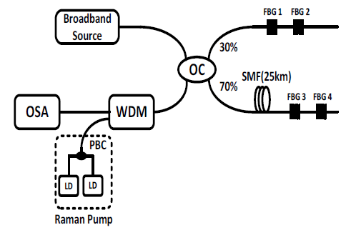
EXPERIMENT
Fig. 1. The Experimental setup of the proposed system
OC: optical coupler
FBG: fiber bragg granting
SMF: single mode fiber
OSA: optical spectrum analyzer
WDM: wavelength division multiplexing coupler
LD: laser diode
PBC: polarization beam combiner
The four FBG sensors have 3-db bandwidth of 0.16nm.
Shows back- reflected wavelength
2x2
1420 and1450 nm

Slide 6
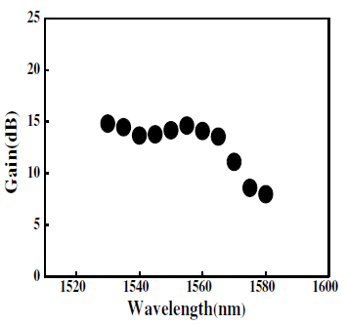
RESULTS
The maximum Raman gain is about 14 dB at 1530 nm.
Fig. 2. Raman gain at different wavelengths

Slide 7
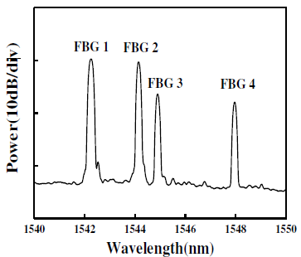
Four peaks correspond to the Bragg wavelengths of the four FBGs.
Due to the 25 km SMF, the power of back-reflect light from 70% output increase by Raman amplifier.
Fig. 3. The Output spectrum of fiber sensor system

Slide 8
CONCLUSIONS
Long-distance fiber sensor system using broadband source and raman amplifier has been proposed and experimentally demonstrated.
Using the Raman amplifier, we can increase the long-distance sensing signal transmission and optimizes the quality of the signal.
Experimental results showed that it is possible to accurately detect the Bragg wavelengths for long-distance sensing FBG systems.

Slide 9
Thank You!!

